Slide 1
Dream House Loan Approval Explanatory Data Analysis
Author: Robert Ramos
3/26/2022

Slide 2

Introduction
The data presented in this presentation is loan application data from Dream House loans. The dataset contains includes data that is critical for determining whether an application is approved or denied and also contains data regarding the location of the home and the loan amount requested.

Slide 3
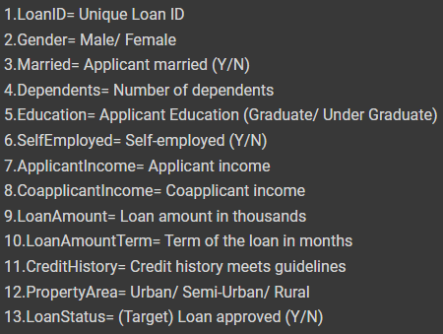
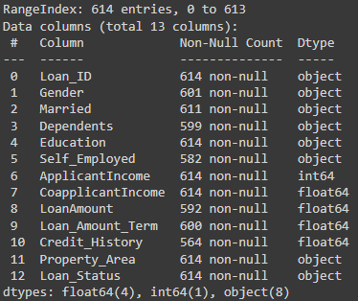
About the Data

Slide 4
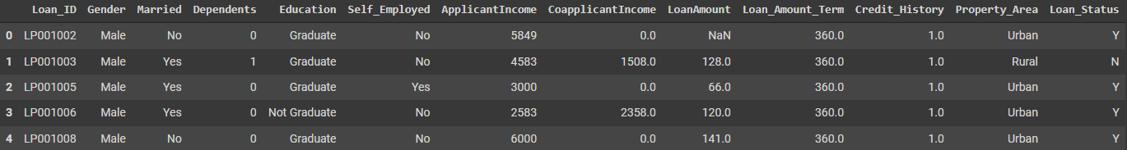
Example of the Dataset
Exploring df_la.head() to look at the first 5 rows of the dataset

Slide 5

My findings
Notes:
Discuss how 80% of the work is in the EDA

Slide 6
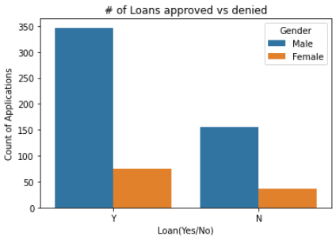
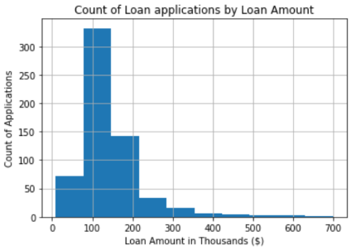
Some highlights of my findings

Slide 7
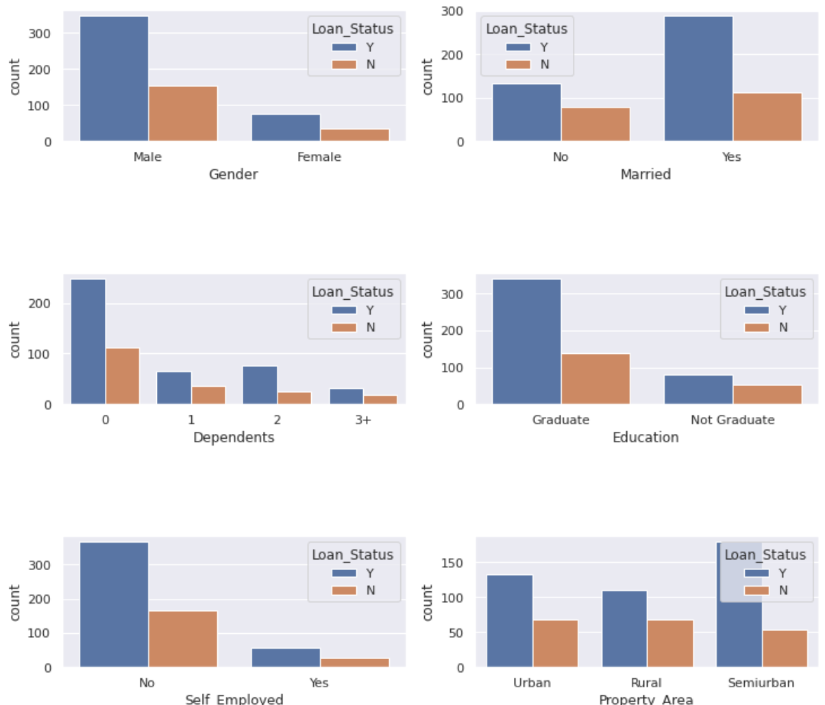
Comparing Approved/Denied Loans vs Categories

Slide 8

Machine Learning Model
Notes:
Discuss how 80% of the work is in the EDA

Slide 9
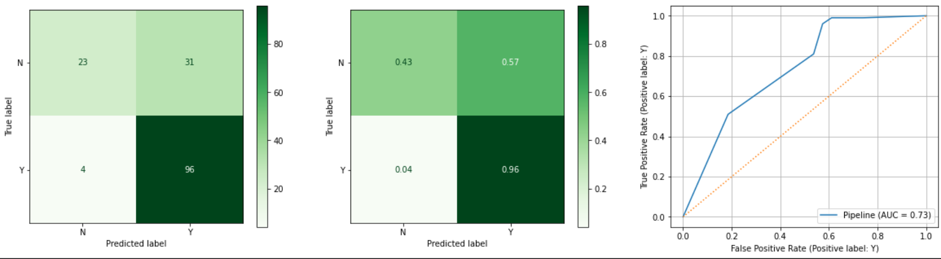
K-Nearest Neighbors Model Results
This model does a great job at predicting the loan applications that get approved but there might be a better model out there that can more accurately predict the applications that are denied based on the confusion matrix and ROC-AUC curve

Slide 10
Recommendations
Though this model is great at predicting approved loans, may need to explore more advanced models to reduce the amount of false positives for denied applications therefore I would not recommend this model to be deployed

Slide 11

Thank You
Robert Ramos
ramos.robertanthony@gmail.com
https://github.com/robertramos89/Dream-Home-Loan-Approval

